Slide 1
Causal Inference Crash Course Part 6: Panel Models
Julian Hsu

Slide 2
Causal Inference Series
Foundations
Defining Some ATE/ATET Causal Models
ATE/ATET Inference, Asymptotic Theory, and Bootstrapping
Best Practices: Outliers, Class Imbalance, Feature Selection, and Bad Control
Heterogeneous Treatment Effect Models and Inference
Difference-in-Difference Models for Panel Data
Regression Discontinuity Models
Arguable Validation

Slide 3
Overview
This presentation will primarily cover how panel models can be used for causal inference, particularly difference-in-difference (DiD) and synthetic control-style models (SC).
We will also discuss the role of prediction in panel models
DiD is the most popular quasi-experimental design in economics for causal inference.
One quarter of NBER Working Paper series used diff-in-diff; and 16% of articles in top five economic journals (Currie et al, 2020)
It exploits panel data to estimate causal impacts

Slide 4
Panel Data

Slide 5


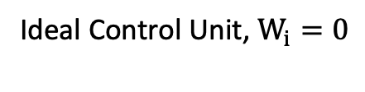
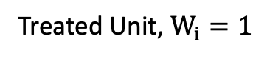

The big picture
Outcome, $Y_{it}$
We track treated and control units over time, and see their outcomes before and after they are treated.
Before treatment, their outcomes have the exact same trend.
We assume that the difference in trends after treatment is due to treatment.
Treated Unit, $W_{i}=1$
Ideal Control Unit, $W_{i}=0$
Pre-Treatment Periods , $t<0$
Post-Treatment Periods , $t≥0$

Slide 6
Comparing trends lets us arguably validate
Outcome, $Y_{it}$
We want to know how the treated unit would behave if we did not treat it.
The more similar pre-treatment trends are, the more we think that the control unit’s post-treatment outcomes represent this.
Treated Unit, $W_{i}=1$
Ideal Control Unit, $W_{i}=0$
Pre-Treatment Periods , $t<0$
Post-Treatment Periods , $t≥0$

Slide 7
Where DiD and SC models come in
Outcome, $Y_{it}$
How do we find the ideal control unit on the right? What if we can’t?
What if treatment is staggered (ie, roll out of a new algorithm over states or stores)?
Treated Unit, $W_{i}=1$
Pre-Treatment Periods , $t<0$
Post-Treatment Periods , $t≥0$

Slide 8
Difference-in-Difference (DiD) Models

Slide 9
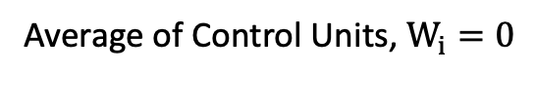
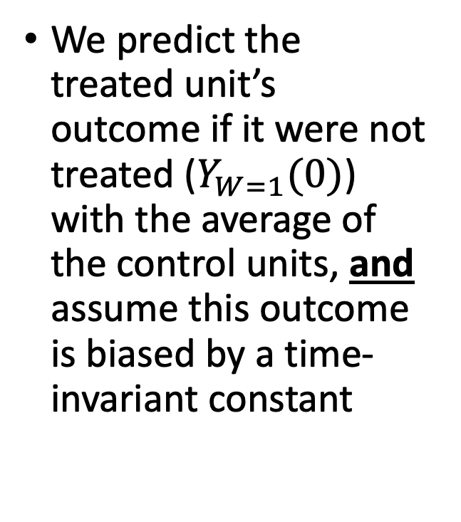
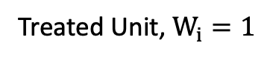
DiD Model
Outcome, $Y_{it}$
We predict the treated unit’s outcome if it were not treated ($Y_{W=1}(0)$) with the average of the control units, and assume this outcome is biased by a time-invariant constant
Treated Unit, $W_{i}=1$
Average of Control Units, $W_{i}=0$
Pre-Treatment Periods , $t<0$
Post-Treatment Periods , $t≥0$

Slide 10
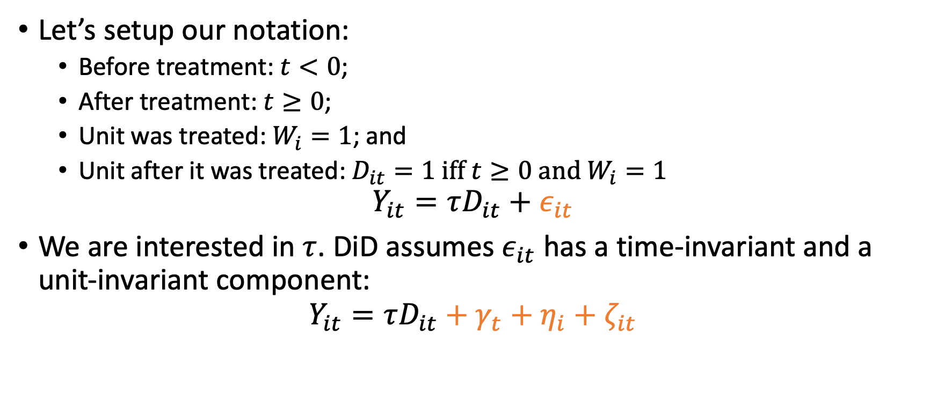
DiD Setup
Let’s setup our notation:
Before treatment: $t<0$;
After treatment: $t≥0$;
Unit was treated: $W_{i}=1$; and
Unit after it was treated: $D_{it}=1 \text{iff} t≥0 \text{and} W_{i}=1$
$$Y_{it}=τD_{it}+ε_{it}$$
We are interested in $τ$. DiD assumes $ε_{it}$ has a time-invariant and a unit-invariant component:
$$Y_{it}=τD_{it}+γ_{t}+η_{i}+ζ_{it}$$

Slide 11
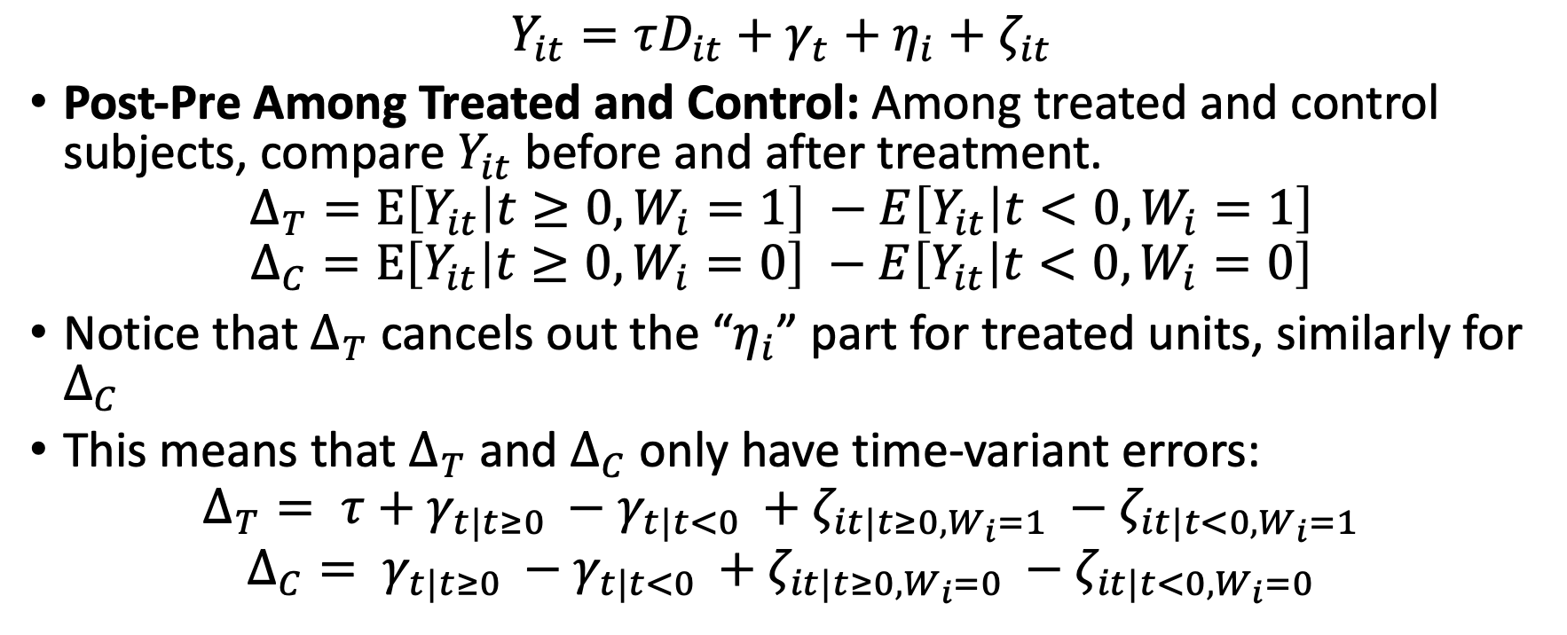
DiD comes from combining two differences
$$Y_{it}=τD_{it}+γ_{t}+η_{i}+ζ_{it}$$
Post-Pre Among Treated and Control: Among treated and control subjects, compare $Y_{it}$ before and after treatment.
$$Δ_{T}=E\left[Y_{it} | t≥0, W_{i}=1\right] −E\left[Y_{it} | t<0, W_{i}=1\right]$$
$$Δ_{C}=E\left[Y_{it} | t≥0, W_{i}=0\right] −E\left[Y_{it} | t<0, W_{i}=0\right]$$
Notice that $Δ_{T}$ cancels out the “$η_{i}$” part for treated units, similarly for $Δ_{C}$
This means that $Δ_{T}$ and $Δ_{C}$ only have time-variant errors:
$$Δ_{T}= τ+γ_{t|t≥0 }−γ_{t|t<0 }+ζ_{it|t≥0, W_{i}=1 }−ζ_{it|t<0,W_{i}=1}$$
$$Δ_{C}= γ_{t|t≥0 }−γ_{t|t<0 }+ζ_{it|t≥0, W_{i}=0 }−ζ_{it|t<0,W_{i}=0}$$

Slide 12
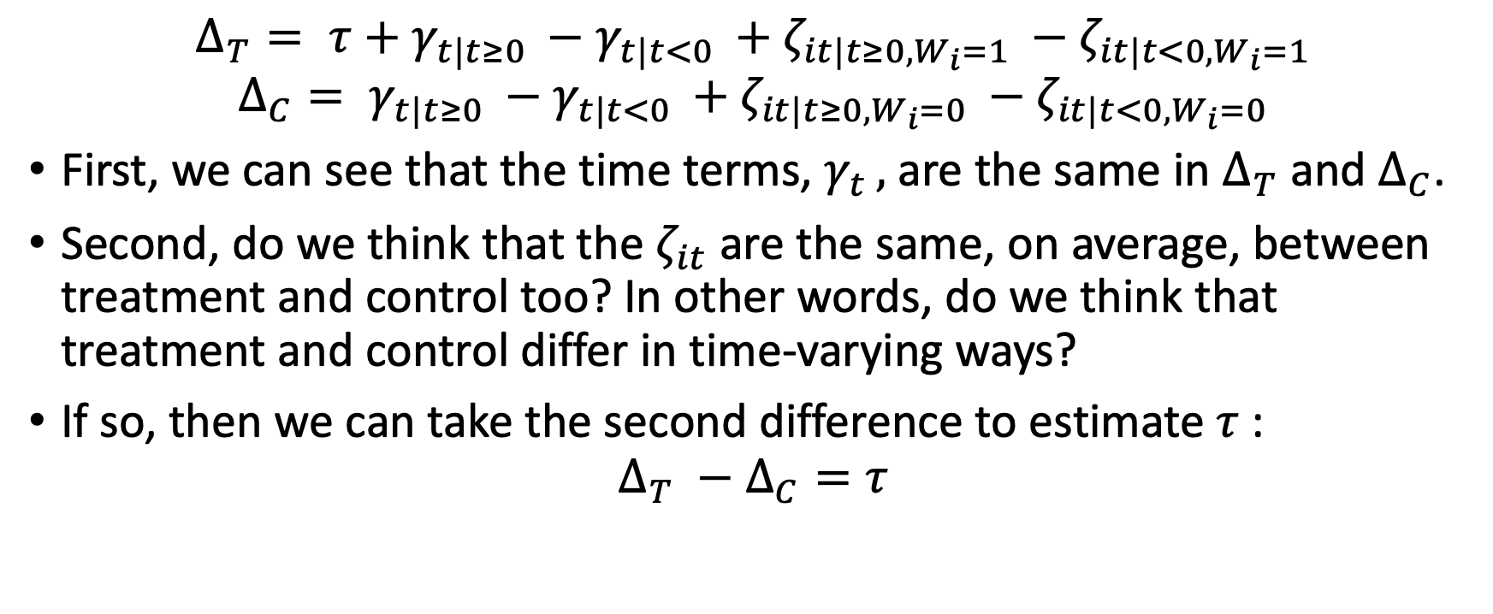
Deriving DiD
$$Δ_{T}= τ+γ_{t|t≥0 }−γ_{t|t<0 }+ζ_{it|t≥0, W_{i}=1 }−ζ_{it|t<0,W_{i}=1}$$
$$Δ_{C}= γ_{t|t≥0 }−γ_{t|t<0 }+ζ_{it|t≥0, W_{i}=0 }−ζ_{it|t<0,W_{i}=0}$$
First, we can see that the time terms, $γ_{t },$ are the same in $Δ_{T}$ and $Δ_{C}$.
Second, do we think that the $ζ_{it}$ are the same, on average, between treatment and control too? In other words, do we think that treatment and control differ in time-varying ways?
If so, then we can take the second difference to estimate $τ$:
$$Δ_{T} −Δ_{C}=τ$$

Slide 13
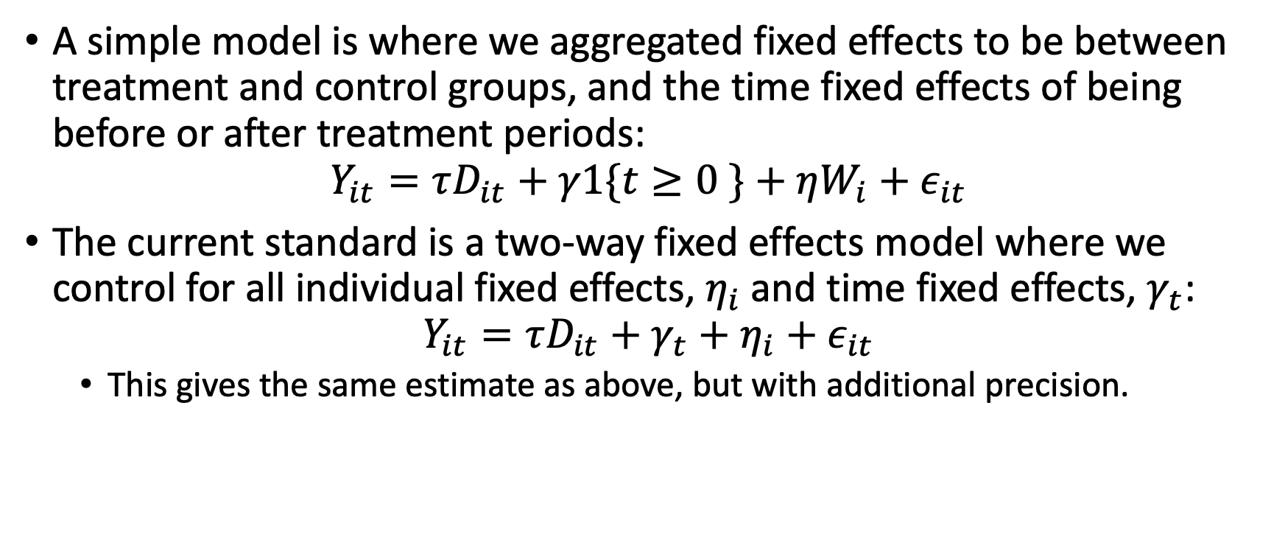
Estimating DiD
A simple model is where we aggregated fixed effects to be between treatment and control groups, and the time fixed effects of being before or after treatment periods:
$$Y_{it}=τD_{it}+γ1\{t≥0 \}+ηW_{i}+ε_{it}$$
The current standard is a two-way fixed effects model where we control for all individual fixed effects, $η_{i}$and time fixed effects, $γ_{t}$:
$$Y_{it}=τD_{it}+γ_{t}+η_{i}+ε_{it}$$
This gives the same estimate as above, but with additional precision.

Slide 14
Validating DiD
If treated and control units vary in time-varying ways that influence their outcomes, then we cannot trust the DiD estimate.
We do not think that the average control trend accurately represents how treated units would perform absent treatment.
We can arguably assess this by looking at whether the predicted control trend is parallel to the treated units.
This is the Parallel Trends test.

Slide 15
Example of Parallel and Non-Parallel Trends
Parallel Trends Test: Yes
Parallel Trends Test: No
Trend for Treated Units
Trend for Treated Units
Predicted Trend for Control Units
Predicted Trend for Control Units

Slide 16
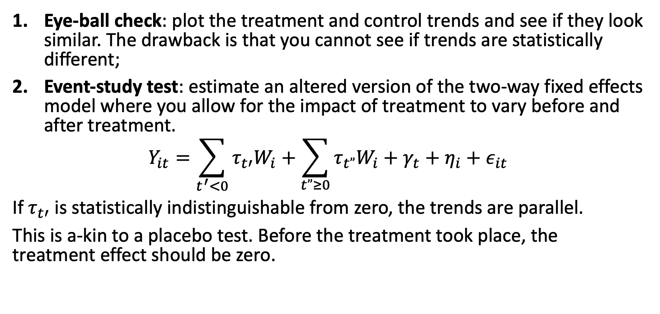
Two ways to Assess this
Eye-ball check: plot the treatment and control trends and see if they look similar. The drawback is that you cannot see if trends are statistically different;
Event-study test: estimate an altered version of the two-way fixed effects model where you allow for the impact of treatment to vary before and after treatment.
$$Y_{it}=\sum_{t^{′}<0}{τ_{t′}W_{i}}+\sum_{t”≥0}{τ_{t”}W_{i}}+γ_{t}+η_{i}+ε_{it}$$ If $τ_{t′}$ is statistically indistinguishable from zero, the trends are parallel.
This is a-kin to a placebo test. Before the treatment took place, the treatment effect should be zero.

Slide 17
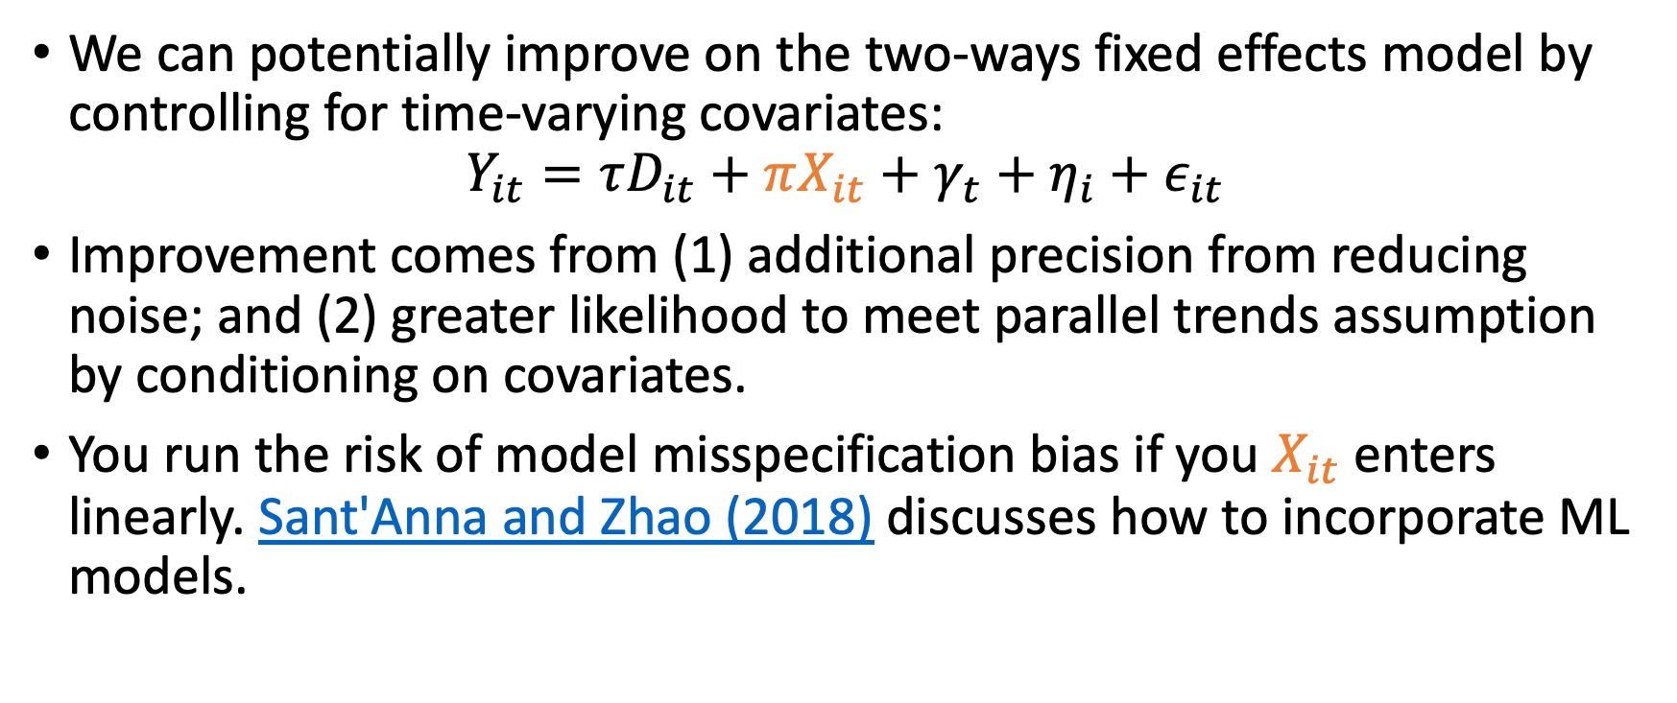
Including Time-Varying Covariates
We can potentially improve on the two-ways fixed effects model by controlling for time-varying covariates:
$$Y_{it}=τD_{it}+πX_{it}+γ_{t}+η_{i}+ε_{it}$$
Improvement comes from (1) additional precision from reducing noise; and (2) greater likelihood to meet parallel trends assumption by conditioning on covariates.
You run the risk of model misspecification bias if you $X_{it}$ enters linearly. Sant'Anna and Zhao (2018) discusses how to incorporate ML models.

Slide 18
More DiD Extended Topics
Roth, Sant'Anna, Bilinski, Poe (2022) for a comprehensive overview of the current literature. Some highlights below:
Staggered Treatment Effects
Chaisemartin and D'Haultfœuille (2020)
Callaway and Sant'Anna (2018)
Continuous Treatment
Callaway, Goodman-Bacon, Sant'Anna
Doubly Robust DiD
Sant'Anna and Zhao (2018)

Slide 19
Synthetic Control
Abadie, Diamond, Hainmueller (2010)
Doudchenko and Imbens (2016)

Slide 20
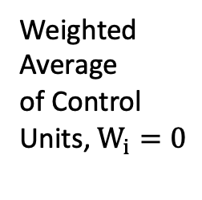
SC Model
Outcome, $Y_{it}$
We predict the treated unit’s outcome if it were not treated with a weighted average of the control units
Weights allow for a data-driven selection of control units
Treated Unit, $W_{i}=1$
Weighted
Average
of Control
Units, $W_{i}=0$
Pre-Treatment Periods , $t<0$
Post-Treatment Periods , $t≥0$

Slide 21
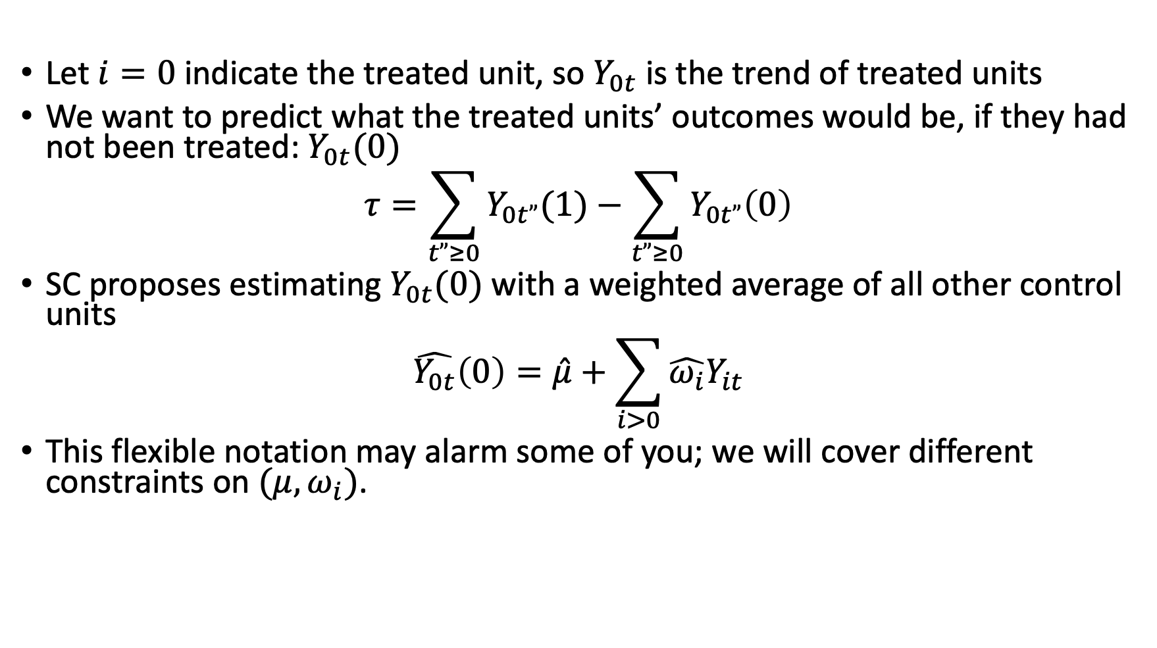
SC Setup
Let $i=0$indicate the treated unit, so $Y_{0t}$ is the trend of treated units
We want to predict what the treated units’ outcomes would be, if they had not been treated: $Y_{0t}(0)$
$$τ=\sum_{t”≥0}{Y_{0t”}(1)}−\sum_{t”≥0}{Y_{0t”}\left(0\right)}$$
SC proposes estimating $Y_{0t}(0)$ with a weighted average of all other control units
$$\hat{Y_{0t}}\left(0\right)=\hat{μ}+\sum_{i>0}{\hat{ω_{i}}Y_{it}}$$
This flexible notation may alarm some of you; we will cover different constraints on $(μ,ω_{i})$.

Slide 22
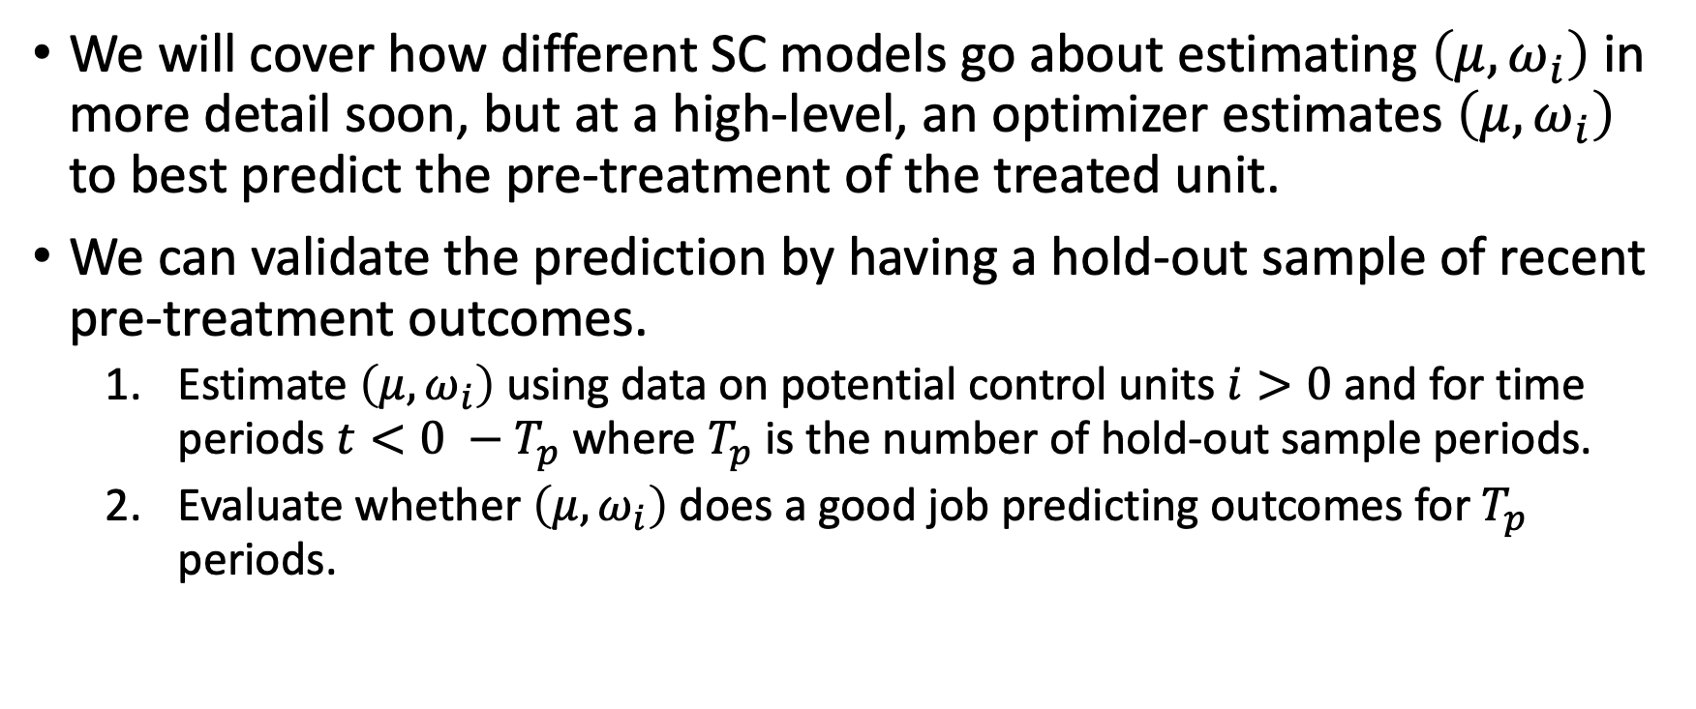
Validating SC Models
We will cover how different SC models go about estimating $\left(μ,ω_{i}\right)$ in more detail soon, but at a high-level, an optimizer estimates $\left(μ,ω_{i}\right)$ to best predict the pre-treatment of the treated unit.
We can validate the prediction by having a hold-out sample of recent pre-treatment outcomes.
Estimate $\left(μ,ω_{i}\right)$ using data on potential control units $i>0$ and for time periods $t<0 −T_{p}$ where $T_{p}$ is the number of hold-out sample periods.
Evaluate whether $\left(μ,ω_{i}\right)$ does a good job predicting outcomes for $T_{p}$ periods.

Slide 23
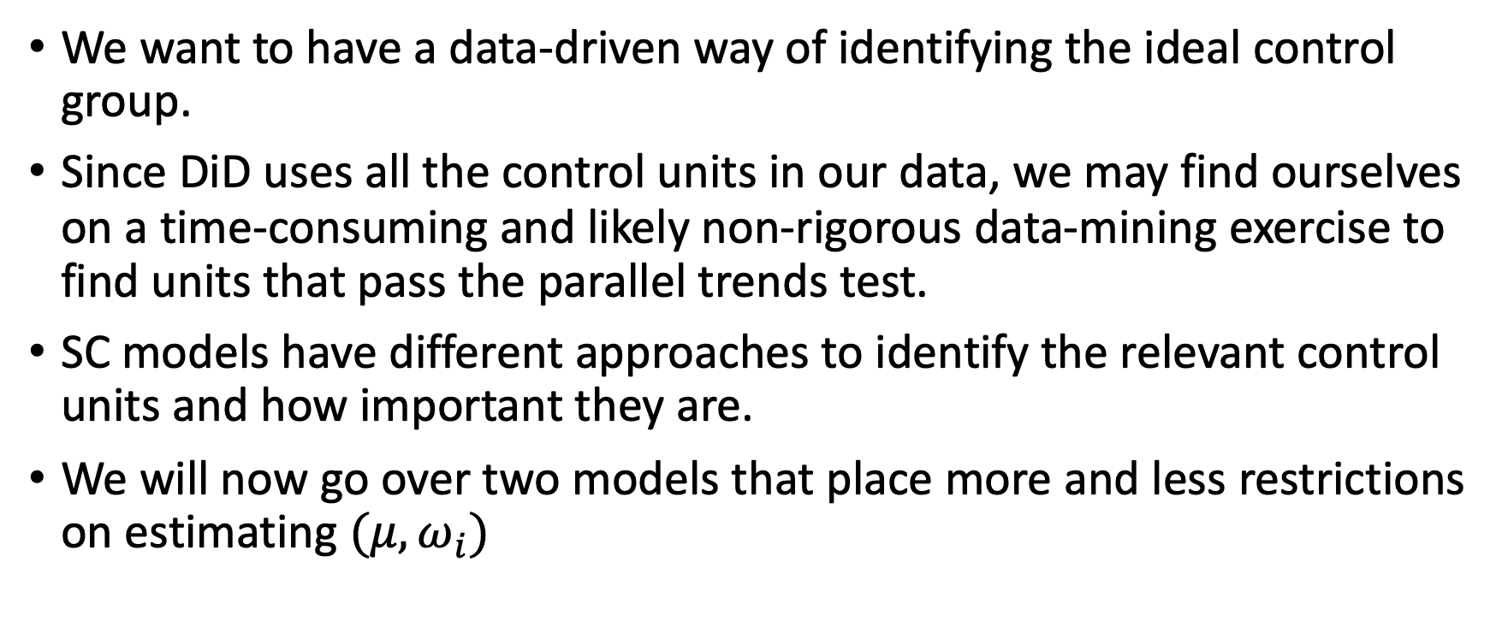
SC, the big idea
We want to have a data-driven way of identifying the ideal control group.
Since DiD uses all the control units in our data, we may find ourselves on a time-consuming and likely non-rigorous data-mining exercise to find units that pass the parallel trends test.
SC models have different approaches to identify the relevant control units and how important they are.
We will now go over two models that place more and less restrictions on estimating ${(μ,ω}_{i})$

Slide 24
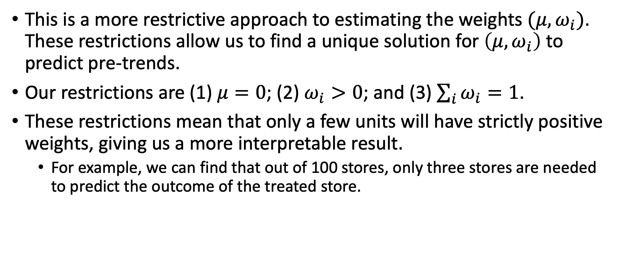
Abadie, Diamond, Hainmueller 2010 (ADH)
This is a more restrictive approach to estimating the weights $(μ,ω_{i})$. These restrictions allow us to find a unique solution for $\left(μ,ω_{i}\right)$ to predict pre-trends.
Our restrictions are (1) $μ=0$; (2) $ω_{i}>0$; and (3) $\sum_{i}{ω_{i}}=1$.
These restrictions mean that only a few units will have strictly positive weights, giving us a more interpretable result.
For example, we can find that out of 100 stores, only three stores are needed to predict the outcome of the treated store.

Slide 25
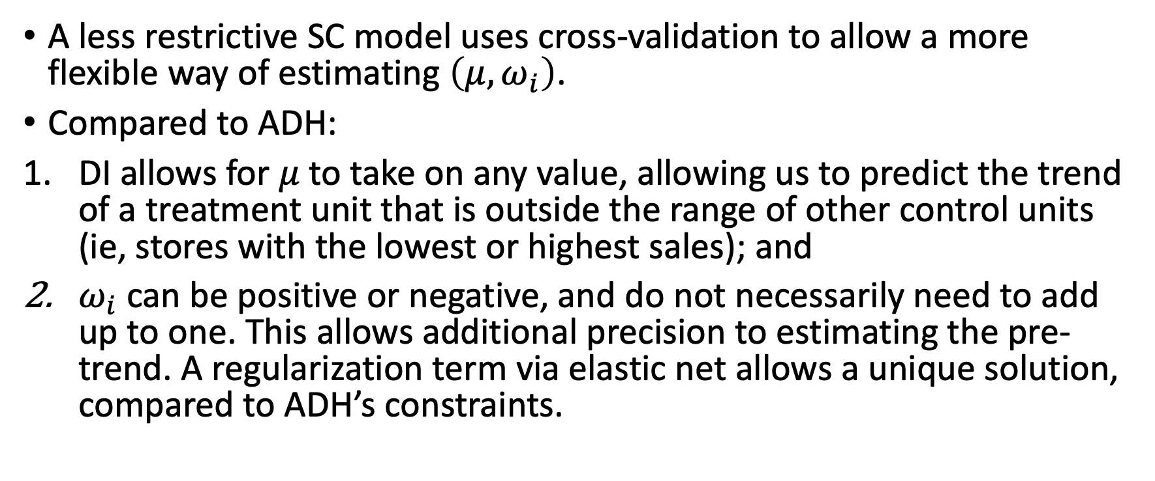
Doudchenko and Imbens 2016 – DI
A less restrictive SC model uses cross-validation to allow a more flexible way of estimating $\left(μ,ω_{i}\right)$.
Compared to ADH:
DI allows for $μ$ to take on any value, allowing us to predict the trend of a treatment unit that is outside the range of other control units (ie, stores with the lowest or highest sales); and
$ω_{i}$ can be positive or negative, and do not necessarily need to add up to one. This allows additional precision to estimating the pre-trend. A regularization term via elastic net allows a unique solution, compared to ADH’s constraints.

Slide 26
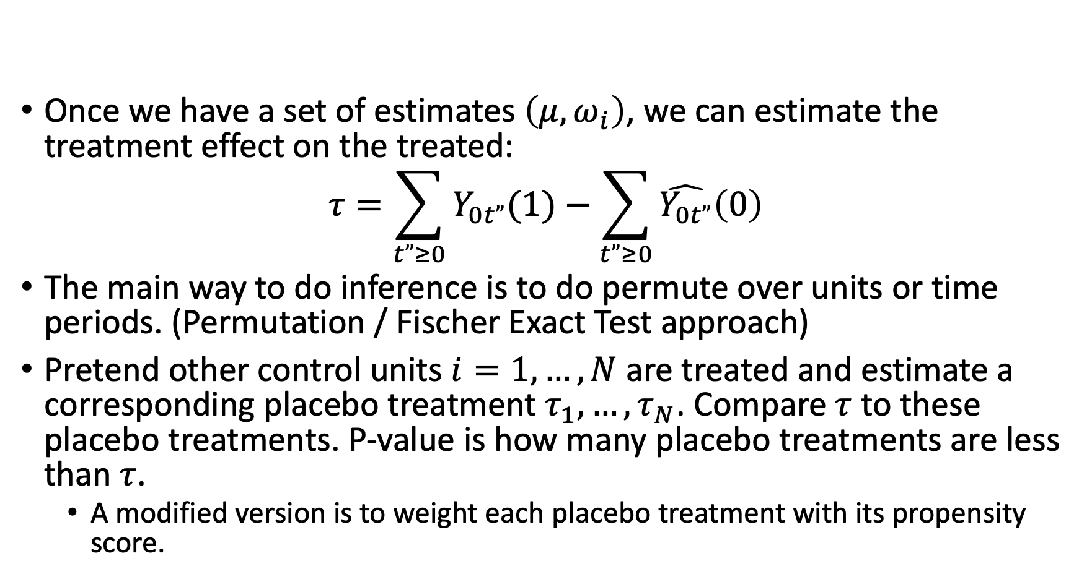
How does inference work?
Once we have a set of estimates $\left(μ,ω_{i}\right)$, we can estimate the treatment effect on the treated:
$$τ=\sum_{t”≥0}{Y_{0t”}(1)}−\sum_{t”≥0}{\hat{Y_{0t”}}\left(0\right)}$$
The main way to do inference is to do permute over units or time periods. (Permutation / Fischer Exact Test approach)
Pretend other control units $i=1,…,N$ are treated and estimate a corresponding placebo treatment $τ_{1},…,τ_{N}$. Compare $τ$ to these placebo treatments. P-value is how many placebo treatments are less than $τ$.
A modified version is to weight each placebo treatment with its propensity score.
Notes:
Conformal Inference: this follows Chernozhukov, Wuthrich, and Zhu (2017). The high-level approach is that given the predicted pre-trend, what is the likelihood of seeing the observed post-treatment trend? Compared to the permutation-based methods, this method is much faster and can be applied to any SC model.

Slide 27
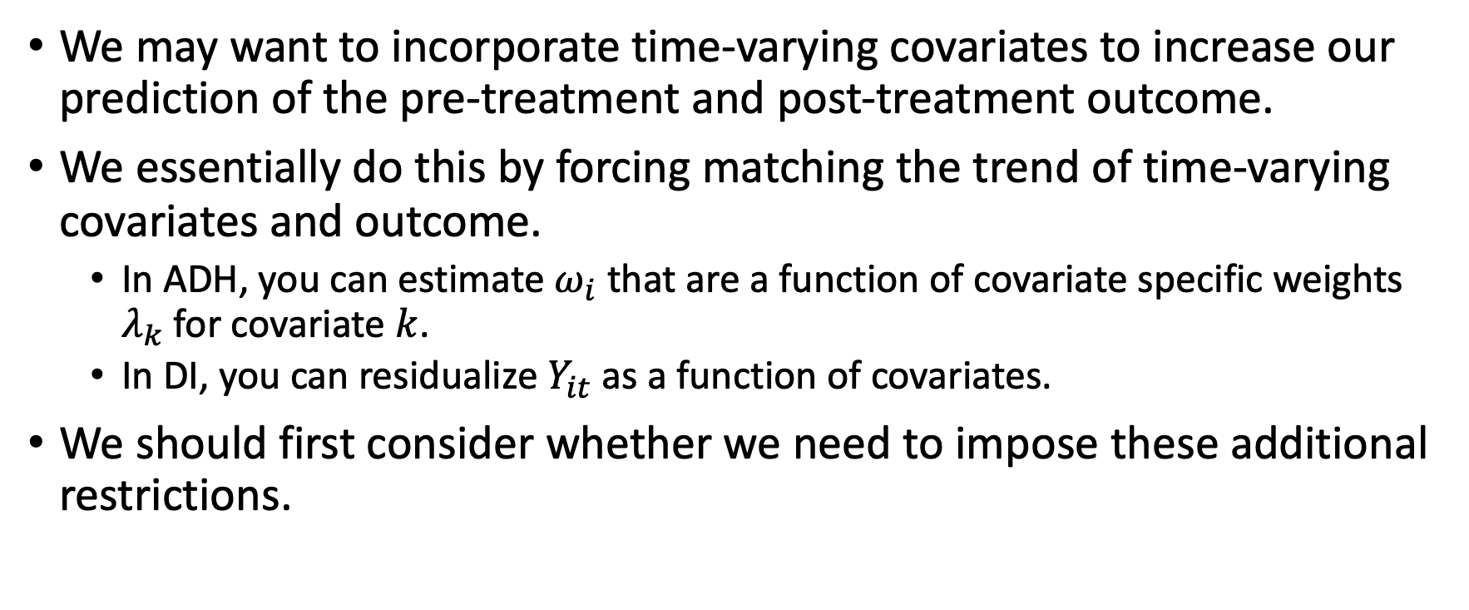
Including Time-Varying Covariates
We may want to incorporate time-varying covariates to increase our prediction of the pre-treatment and post-treatment outcome.
We essentially do this by forcing matching the trend of time-varying covariates and outcome.
In ADH, you can estimate $ω_{i}$ that are a function of covariate specific weights $λ_{k}$ for covariate $k$.
In DI, you can residualize $Y_{it}$ as a function of covariates.
We should first consider whether we need to impose these additional restrictions.

Slide 28
Extended SC Topics
Check out Abadie 2021 for a review of the literature.
Other ways of doing inference
Prediction Intervals via Cattaneo, Feng, Titiunik (2019)
Conformal Inference via Chernozhukov, Wuthrich, and Zhu (2017)
K-Fold approach to estimating SC Models
Chernozhukov, Wuthrich, Zhu 2018
Adding time-specific weights via synthetic DiD
Arkhangelsky, Athey, Hirschberg, Imbens, Wager 2021

Slide 29
DiD vs SC
 | DiD | SC
Control Group Definition | Unweighted average of all potential controls, allowing for a time-invariant difference | Weighted average for a subset of all potential controls to exactly match treatment
Computation Speed | OLS is fast. | Optimizers can take a while.
Inference Procedure | Done with OLS | Permutation; or others (see Chernozhukov, Wuthrich, Zhu (2018), Cattangeo, Feng, Titiunik (2019). )
Validation | Parallel Trends Test with event study model | Prediction validation of hold-out pre-treatment outcomes
Time-Varying Covariates | Linearly, or with ML models via doubly robust methods. | Depends on the SC model

Slide 30
Appendix and Old Slides

Slide 31
Defining the difference-in-difference estimator

Slide 32
Foundation using panel data
Panel data is when each subject is tracked across multiple time periods. For example, knowing the purchase history of a given customer or account for each calendar day.
With greater data storage capacity, panel data is becoming more available to scientists for analysis.

Slide 33
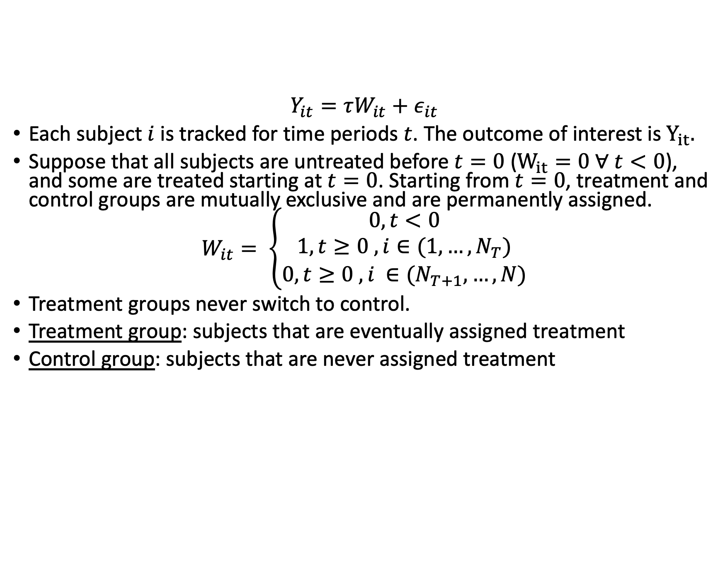
Simple panel data set
$$Y_{it}=τW_{it}+ε_{it}$$
Each subject $i$ is tracked for time periods $t$. The outcome of interest is $Y_{it}.$
Suppose that all subjects are untreated before $t=0$ ($W_{it}=0 ∀ t<0$), and some are treated starting at $t=0$. Starting from $t=0$, treatment and control groups are mutually exclusive and are permanently assigned.
$$W_{it}= \left\{\begin{aligned}0, t<0 \\ 1, t≥0 &, i∈(1,…,N_{T})& \\ 0, t≥0 , i ∈(N_{T+1},…,N)\end{aligned}\right.$$
Treatment groups never switch to control.
Treatment group: subjects that are eventually assigned treatment
Control group: subjects that are never assigned treatment

Slide 34
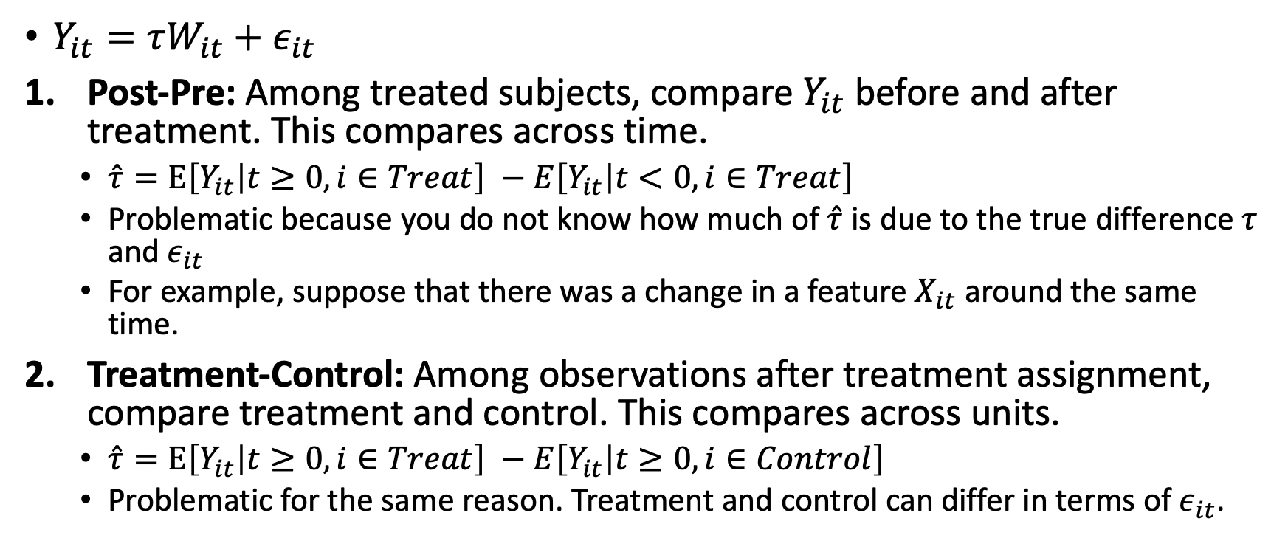
Two naïve comparisons
$Y_{it}=τW_{it}+ε_{it}$
Post-Pre: Among treated subjects, compare $Y_{it}$ before and after treatment. This compares across time.
$\hat{τ}=E\left[Y_{it} | t≥0, i∈Treat\right] −E\left[Y_{it} | t<0, i∈Treat\right]$
Problematic because you do not know how much of $\hat{τ}$ is due to the true difference $τ$ and $ε_{it}$
For example, suppose that there was a change in a feature $X_{it}$ around the same time.
Treatment-Control: Among observations after treatment assignment, compare treatment and control. This compares across units.
$\hat{τ}=E\left[Y_{it} | t≥0, i∈Treat\right] −E\left[Y_{it} | t≥0, i∈Control\right]$
Problematic for the same reason. Treatment and control can differ in terms of $ε_{it}$.

Slide 35
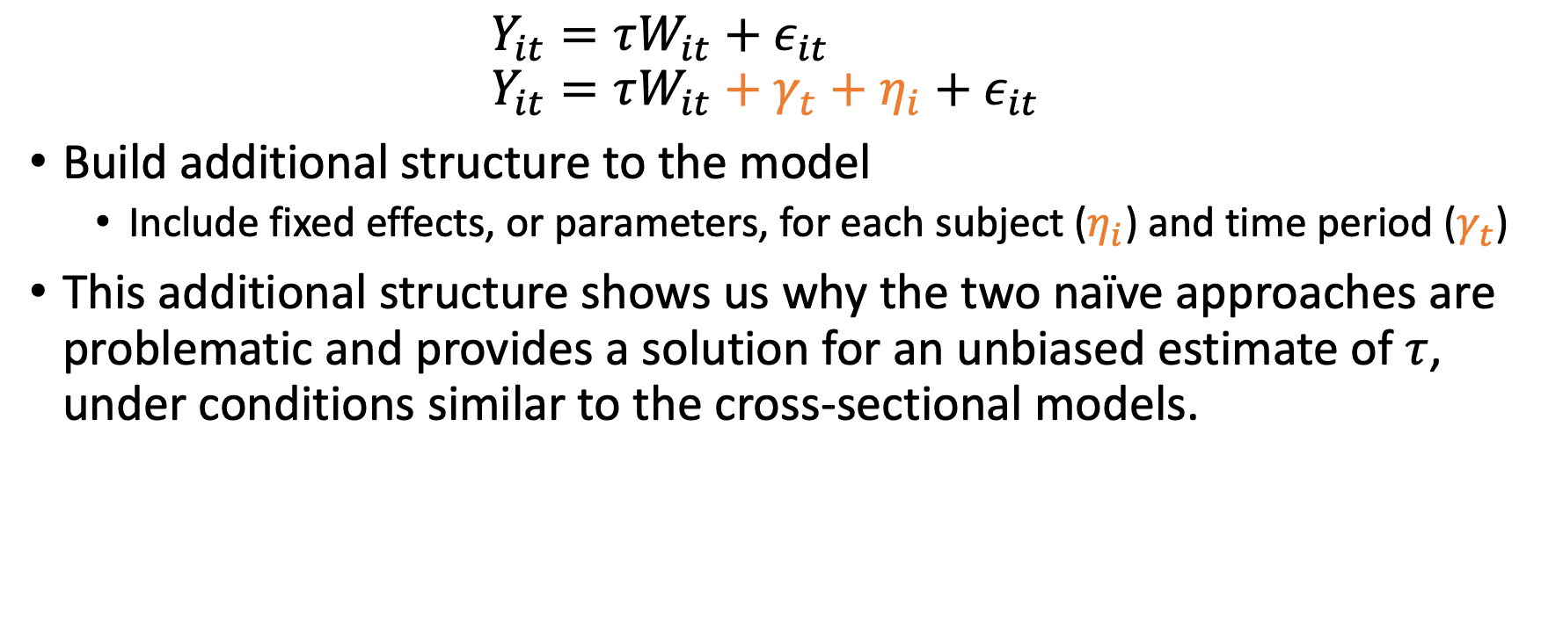
Instead, let’s compare across time and units
$$Y_{it}=τW_{it}+ε_{it}$$
$$Y_{it}=τW_{it}+γ_{t}+η_{i}+ε_{it}$$
Build additional structure to the model
Include fixed effects, or parameters, for each subject ($η_{i}$) and time period ($γ_{t}$)
This additional structure shows us why the two naïve approaches are problematic and provides a solution for an unbiased estimate of $τ$, under conditions similar to the cross-sectional models.

Slide 36
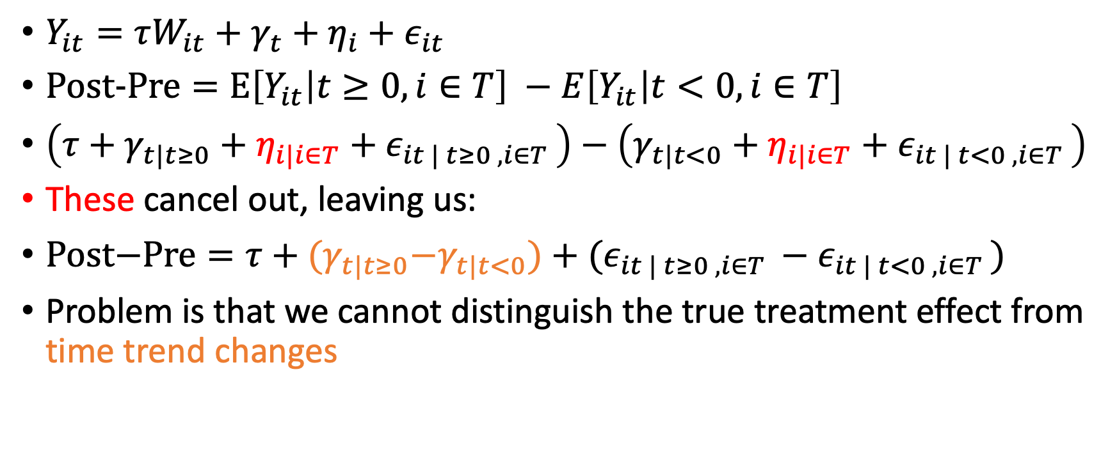
Revising the naïve comparison: Post-Pre
$Y_{it}=τW_{it}+γ_{t}+η_{i}+ε_{it}$
$\text{Post}\text{−}\text{Pre}=E\left[Y_{it} | t≥0, i∈T\right] −E\left[Y_{it} | t<0, i∈T\right]$
$\left(τ+γ_{t|t≥0}+η_{i|i∈T}+ε_{it | t≥0 , i∈T }\right)−\left(γ_{t|t<0}+η_{i|i∈T}+ε_{it | t<0 , i∈T }\right)$
These cancel out, leaving us:
$\text{Post}\text{−}\text{Pre}=τ+{(γ}_{t|t≥0}−γ_{t|t<0})+(ε_{it | t≥0 , i∈T }−ε_{it | t<0 , i∈T })$
Problem is that we cannot distinguish the true treatment effect from time trend changes

Slide 37
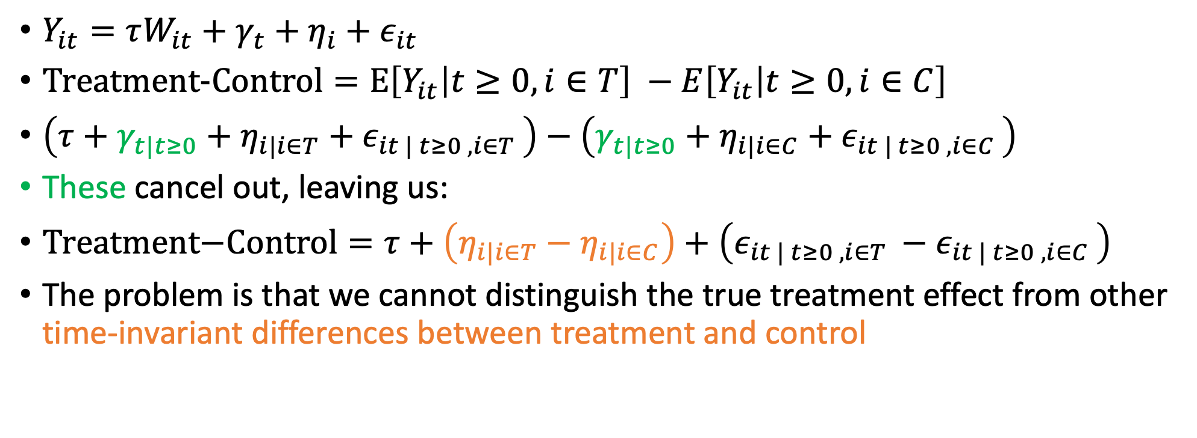
Revising the naïve comparison: Treatment-Control
$Y_{it}=τW_{it}+γ_{t}+η_{i}+ε_{it}$
$\text{Treatment}\text{−}\text{Control}=E\left[Y_{it} | t≥0, i∈T\right] −E\left[Y_{it} | t≥0, i∈C\right]$
$\left(τ+γ_{t|t≥0}+η_{i|i∈T}+ε_{it | t≥0 , i∈T }\right)−\left(γ_{t|t≥0}+η_{i|i∈C}+ε_{it | t≥0 , i∈C }\right)$
These cancel out, leaving us:
$\text{Treatment}\text{−}\text{Control}=τ+\left(η_{i|i∈T}−η_{i|i∈C}\right)+\left(ε_{it | t≥0 , i∈T }−ε_{it | t≥0 , i∈C }\right)$
The problem is that we cannot distinguish the true treatment effect from other time-invariant differences between treatment and control

Slide 38
Construct the diff-in-diff estimator
The naïve comparisons suffer from being unable to distinguish between time-variant and time-invariant differences between treatment and control.
Propose combining these two approaches to compensate for each others shortcomings:
Intuitively, take two differences:
1. Treatment subjects before and after treatment time; and
2. Control subjects before and after treatment time.
and then take the difference between them.

Slide 39
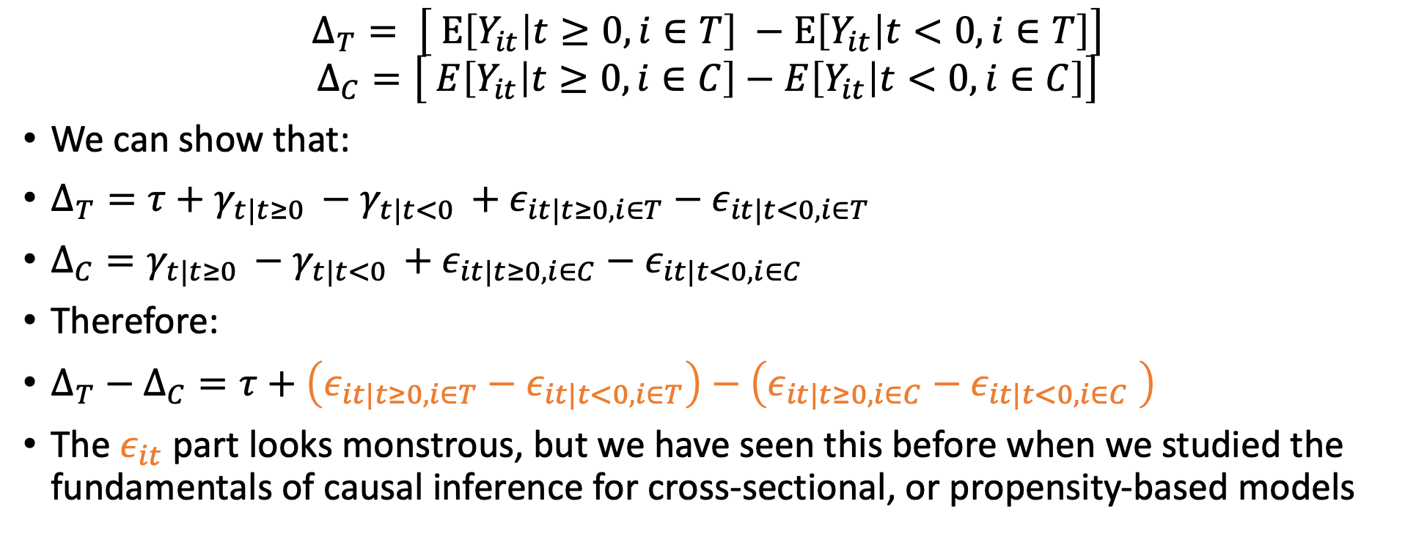
Diff-in-diff estimator
$$Δ_{T}= \left[ E\left[Y_{it} | t≥0, i∈T\right] −E\left[Y_{it} | t<0, i∈T\right]\right]$$
$$Δ_{C}=\left[ E\left[Y_{it} | t≥0, i∈C\right]−E\left[Y_{it} | t<0, i∈C\right]\right]$$
We can show that:
$Δ_{T}=τ+γ_{t|t≥0 }−γ_{t|t<0 }+ε_{it|t≥0, i∈T}−ε_{it|t<0, i∈T}$
$Δ_{C}=γ_{t|t≥0 }−γ_{t|t<0 }+ε_{it|t≥0, i∈C}−ε_{it|t<0, i∈C}$
Therefore:
$Δ_{T}−Δ_{C}=τ+\left(ε_{it|t≥0, i∈T}−ε_{it|t<0, i∈T}\right)−\left(ε_{it|t≥0, i∈C}−ε_{it|t<0, i∈C} \right)$
The $ε_{it}$ part looks monstrous, but we have seen this before when we studied the fundamentals of causal inference for cross-sectional, or propensity-based models

Slide 40
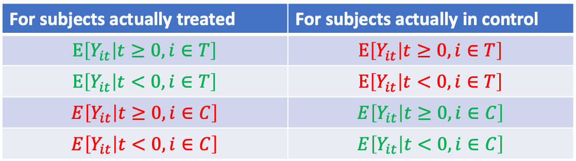
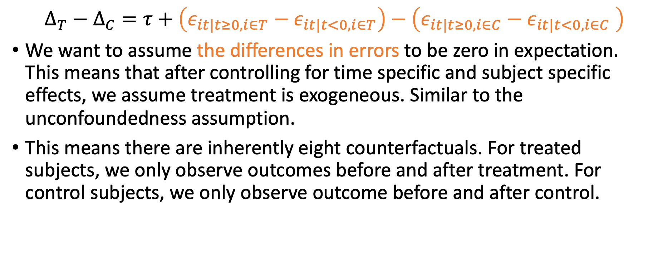
Unconfoundedness, again
$$Δ_{T}−Δ_{C}=τ+\left(ε_{it|t≥0, i∈T}−ε_{it|t<0, i∈T}\right)−\left(ε_{it|t≥0, i∈C}−ε_{it|t<0, i∈C} \right)$$
We want to assume the differences in errors to be zero in expectation. This means that after controlling for time specific and subject specific effects, we assume treatment is exogeneous. Similar to the unconfoundedness assumption.
This means there are inherently eight counterfactuals. For treated subjects, we only observe outcomes before and after treatment. For control subjects, we only observe outcome before and after control.
For subjects actually treated | For subjects actually in control
$$E\left[Y_{it} | t≥0, i∈T\right]$$ | $$E\left[Y_{it} | t≥0, i∈T\right]$$
$$E\left[Y_{it} | t<0, i∈T\right]$$ | $$E\left[Y_{it} | t<0, i∈T\right]$$
$$E\left[Y_{it} | t≥0, i∈C\right]$$ | $$E\left[Y_{it} | t≥0, i∈C\right]$$
$$E\left[Y_{it} | t<0, i∈C\right]$$ | $$E\left[Y_{it} | t<0, i∈C\right]$$
Observed
Not observed

Slide 41
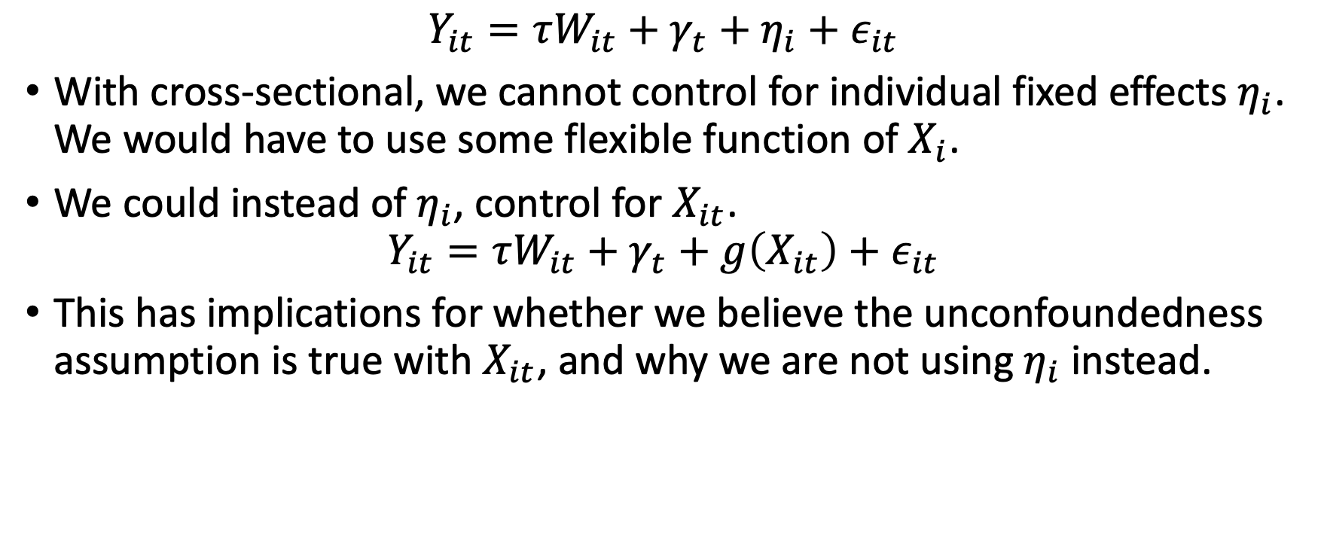
Panel data’s advantage over cross-sectional data
$$Y_{it}=τW_{it}+γ_{t}+η_{i}+ε_{it}$$
With cross-sectional, we cannot control for individual fixed effects $η_{i}$. We would have to use some flexible function of $X_{i}$.
We could instead of $η_{i}$, control for $X_{it}$.
$$Y_{it}=τW_{it}+γ_{t}+g\left(X_{it}\right)+ε_{it}$$
This has implications for whether we believe the unconfoundedness assumption is true with $X_{it}$, and why we are not using $η_{i}$ instead.
Notes:
A cool advantage of contolling for X_i instead of the subject fixed effects is that it gives you more flexibility for modifications such as dynamic learning or dynamic discrete choice models. These are very much outside the scope of these materials.

Slide 42
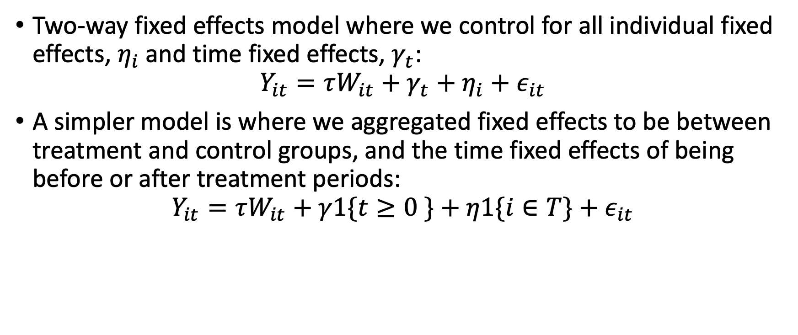
Difference-in-difference model
Two-way fixed effects model where we control for all individual fixed effects, $η_{i}$and time fixed effects, $γ_{t}$:
$$Y_{it}=τW_{it}+γ_{t}+η_{i}+ε_{it}$$
A simpler model is where we aggregated fixed effects to be between treatment and control groups, and the time fixed effects of being before or after treatment periods:
$$Y_{it}=τW_{it}+γ1\{t≥0 \}+η1\{i∈T\}+ε_{it}$$

Slide 43
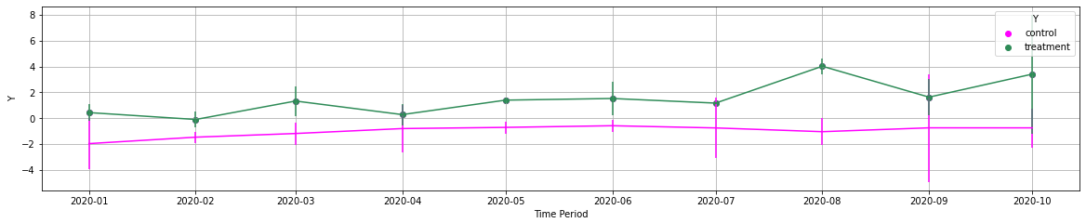
Let’s see this come out in simulation evidence
We generate a panel of outcome data, with seven pre-treatment periods, and three post-treatment periods.
Pre-treatment Periods
Post-Treatment Periods

Slide 44
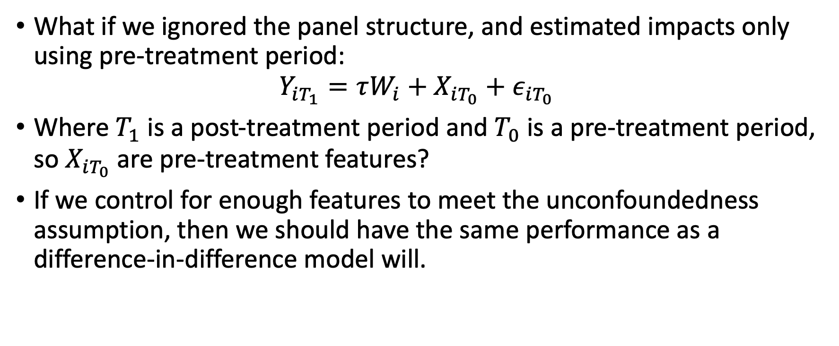
Compare performance of cross-sectional to panel methods
What if we ignored the panel structure, and estimated impacts only using pre-treatment period:
$$Y_{iT_{1}}=τW_{i}+X_{iT_{0}}+ε_{iT_{0}}$$
Where $T_{1}$ is a post-treatment period and $T_{0}$ is a pre-treatment period, so $X_{iT_{0}}$ are pre-treatment features?
If we control for enough features to meet the unconfoundedness assumption, then we should have the same performance as a difference-in-difference model will.
Notes:
In applications, we cannot as easily assume that we assume enough data to meet the unconfoundedness assumption, and this is another vote for DnD models.

Slide 45
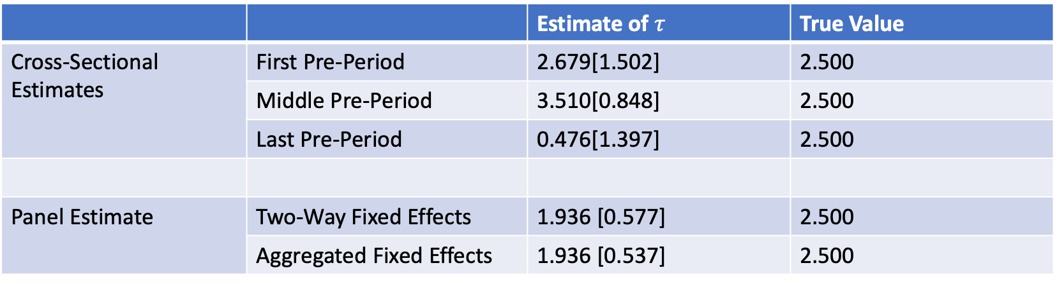
Simulation evidence of cross-sectional and panel data
 |  | Estimate of $τ$ | True Value
Cross-Sectional Estimates | First Pre-Period | 2.679[1.502] | 2.500
 | Middle Pre-Period | 3.510[0.848] | 2.500
 | Last Pre-Period | 0.476[1.397] | 2.500
Panel Estimate | Two-Way Fixed Effects | 1.936 [0.577] | 2.500
 | Aggregated Fixed Effects | 1.936 [0.537] | 2.500
Performance of cross-sectional models can vary over pre-treatment periods, but we have more consistent performance

Slide 46
Arguable validation using panel data

Slide 47
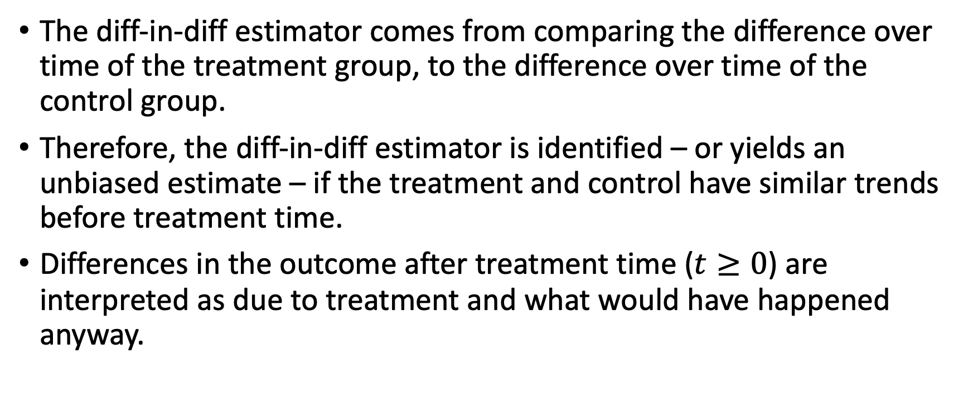
Difference-in-difference
The diff-in-diff estimator comes from comparing the difference over time of the treatment group, to the difference over time of the control group.
Therefore, the diff-in-diff estimator is identified – or yields an unbiased estimate – if the treatment and control have similar trends before treatment time.
Differences in the outcome after treatment time ($t≥0$) are interpreted as due to treatment and what would have happened anyway.

Slide 48



Visual representation – Two Differences
Outcome, $Y_{it}$
Treatment
Difference post-treatment
Control
Difference pre-treatment
Pre-treatment, $t<0$
Post-treatment, $t≥0$

Slide 49

Visual representation – Difference in Differences
Treatment
Outcome, $Y_{it}$
Treatment Effect
Estimated counterfactual of treatment
Control
Pre-treatment, $t<0$
Post-treatment, $t≥0$

Slide 50
Pre-trend tests
If treatment and control groups do not have parallel trends in outcomes pre-treatment, then we cannot distinguish how much of the post-treatment difference is due to the true treatment effect and what would have happened anyway.
If the treatment was on a different trajectory of the control, then how can we be sure how the treatment would have behaved if it were not treated?

Slide 51
Visual representation – No Parallel Trends
Treatment
Outcome, $Y_{it}$
Treatment Effect
Estimated counterfactual of treatment
Control
Pre-treatment, $t<0$
Post-treatment, $t≥0$

Slide 52
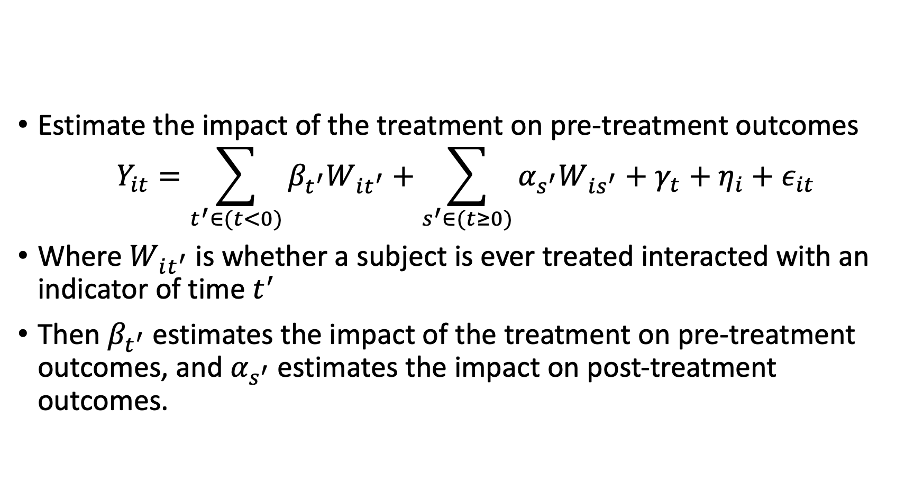
Pre-trend tests
Estimate the impact of the treatment on pre-treatment outcomes
$$Y_{it}=\sum_{t^{′}∈(t<0)}{β_{t^{′}}W_{it^{′}}+\sum_{s^{′}∈(t≥0)}{α_{s^{′}}W_{is^{′}}}}+γ_{t}+η_{i}+ε_{it}$$
Where $W_{it^{′}}$ is whether a subject is ever treated interacted with an indicator of time $t^{′}$
Then $β_{t^{′}}$ estimates the impact of the treatment on pre-treatment outcomes, and $α_{s^{′}}$ estimates the impact on post-treatment outcomes.

Slide 54
Staggered treatment time

Slide 55
Identification deep dive

Slide 56
Identification deep dive
Controlling for lagged outcome or not, and its implication for inference
Controlling for features instead of fixed effects

Slide 57
Continuous treatments

